Slide 1
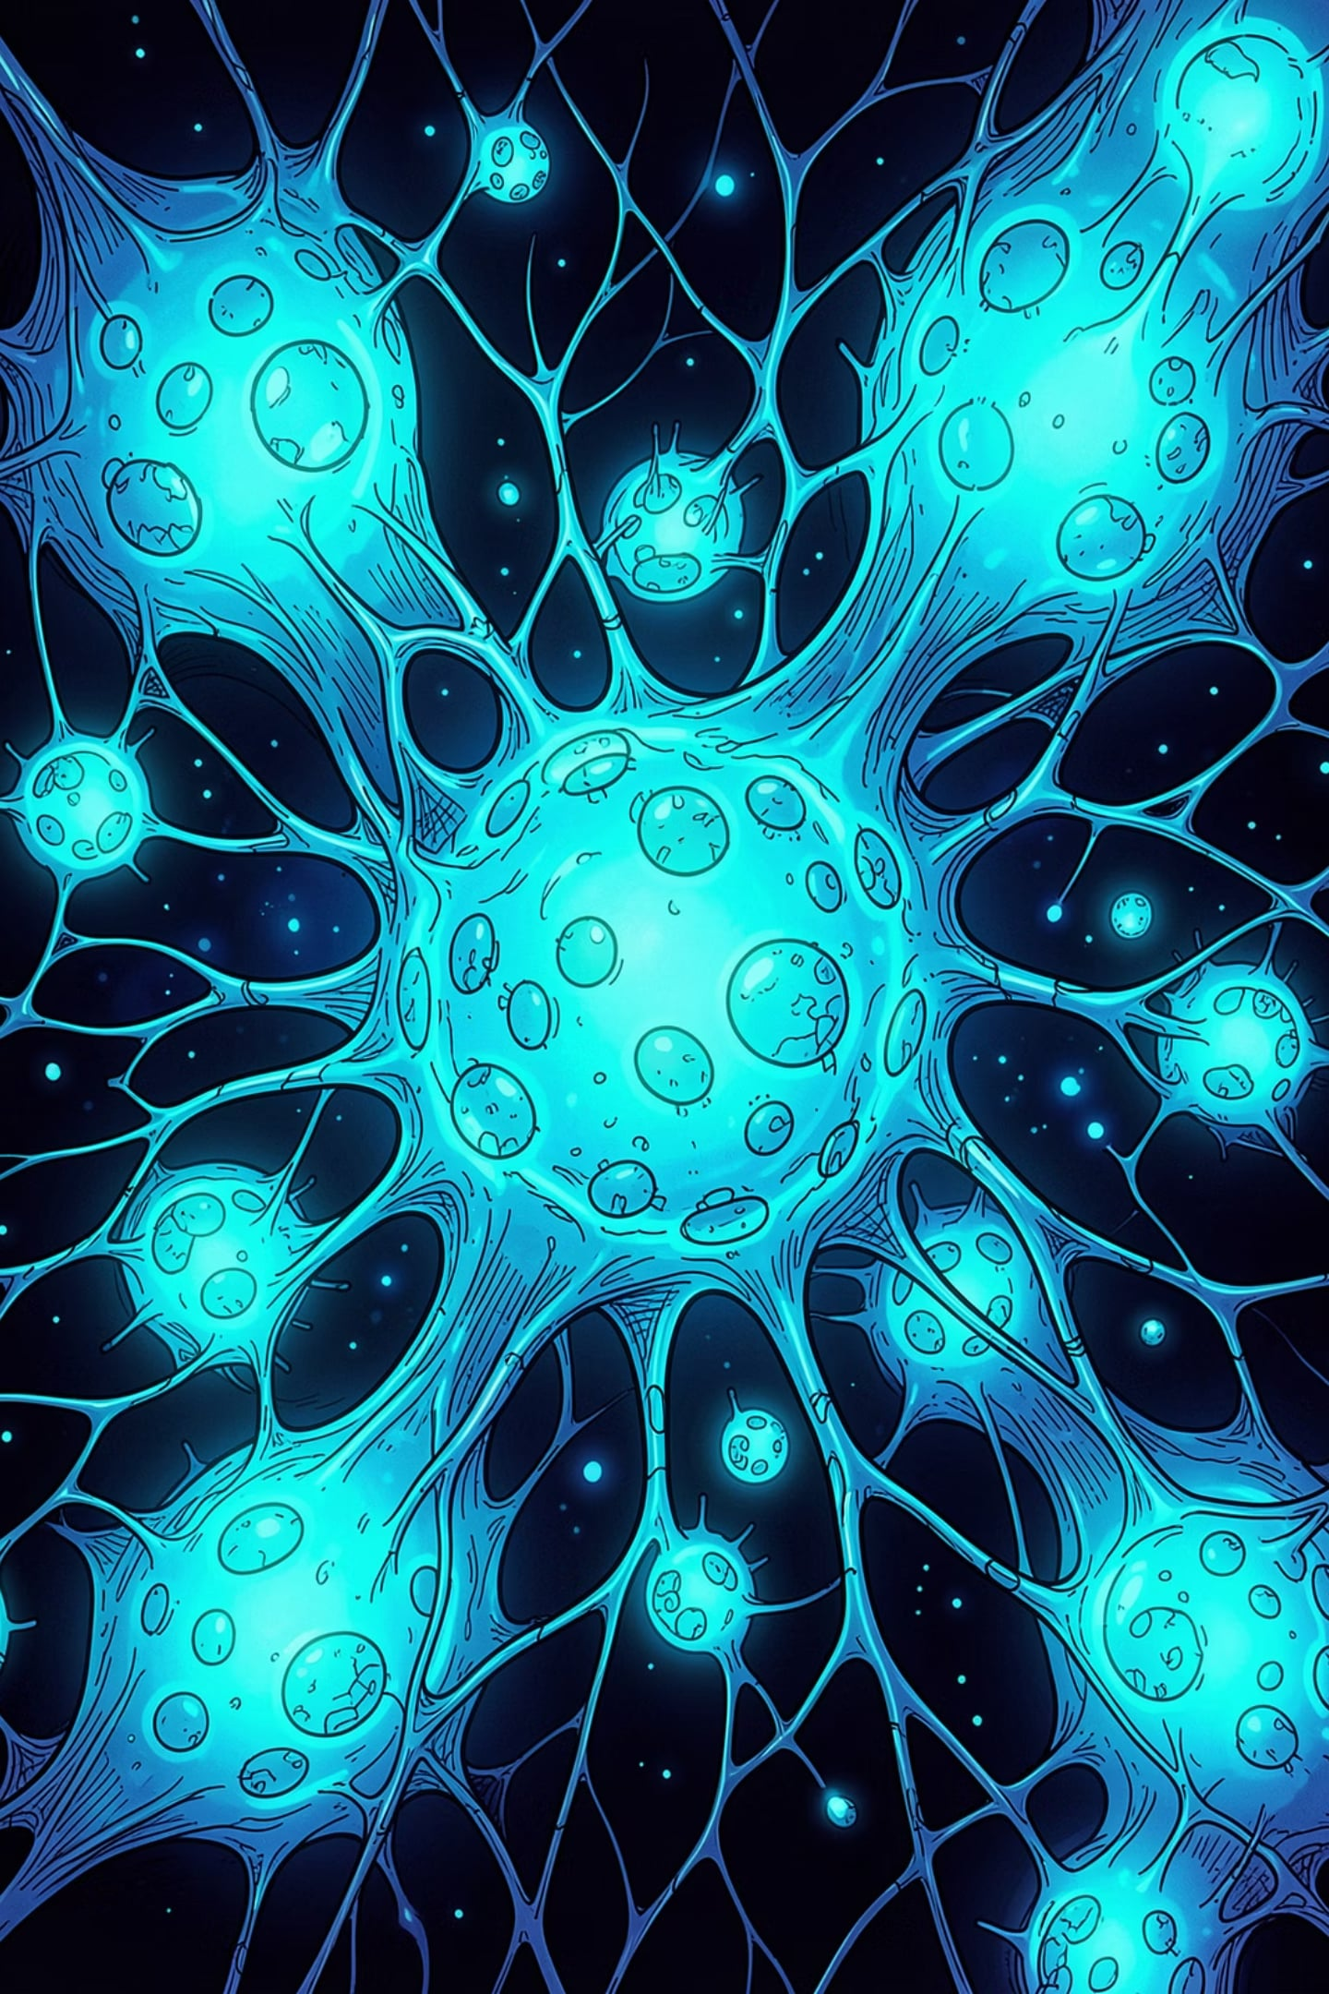
AI · COMPUTER VISION · DEEP LEARNING · BIOMEDICAL IMAGING
CellDynamics AI
Intelligent Cell Segmentation, Multi-Object Tracking, and Temporal Cellular Analysis Platform
CBSE SKILL EXPO 2026
PRESENTED BY
VRUSHABH .S AND RITVIK

Slide 2
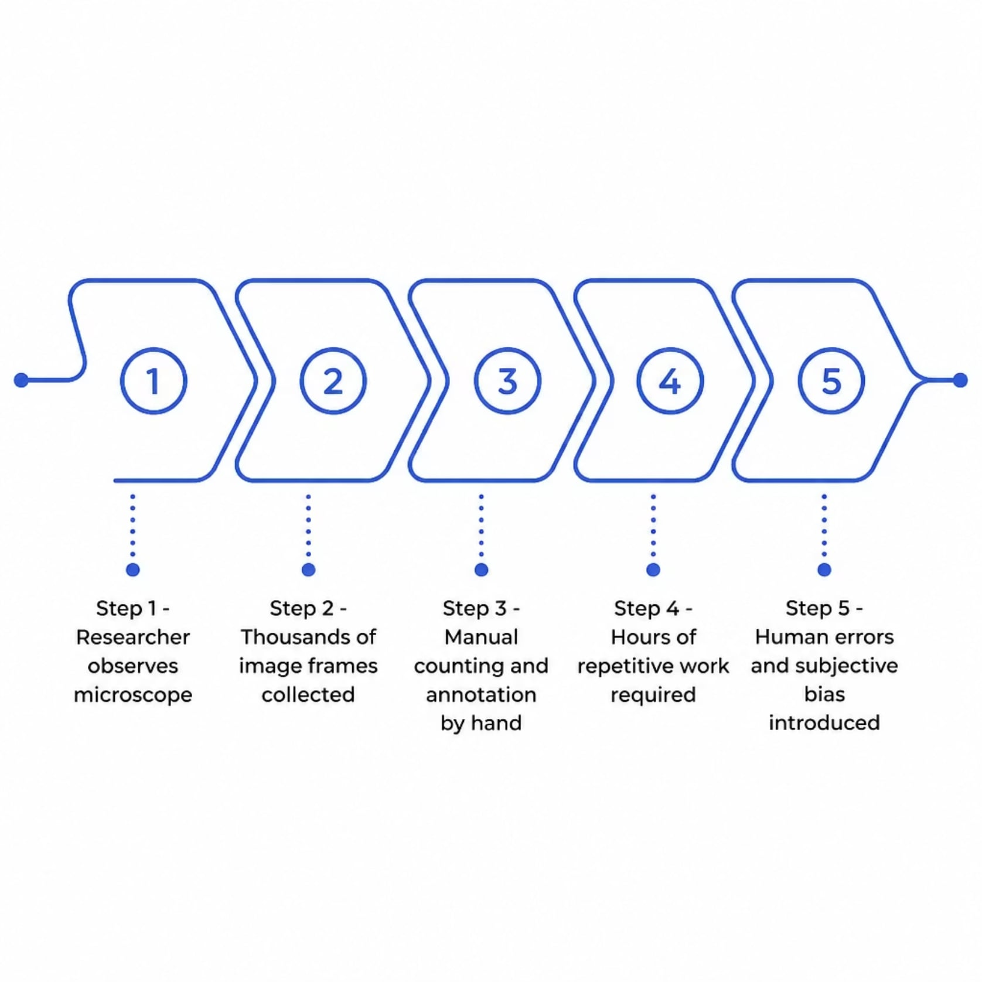
The Problem: Manual Analysis at Scale
Biologists manually analyze thousands of microscopy frames — a process that is slow, error-prone, and impossible to scale. Large datasets cannot be processed efficiently without automation.
⏱ Time Cost
Hours of manual work per dataset
⚠ Error Rate
Subjective, inconsistent observations
📦 Scale Gap
Thousands of moving cells cannot be monitored simultaneously

Slide 3
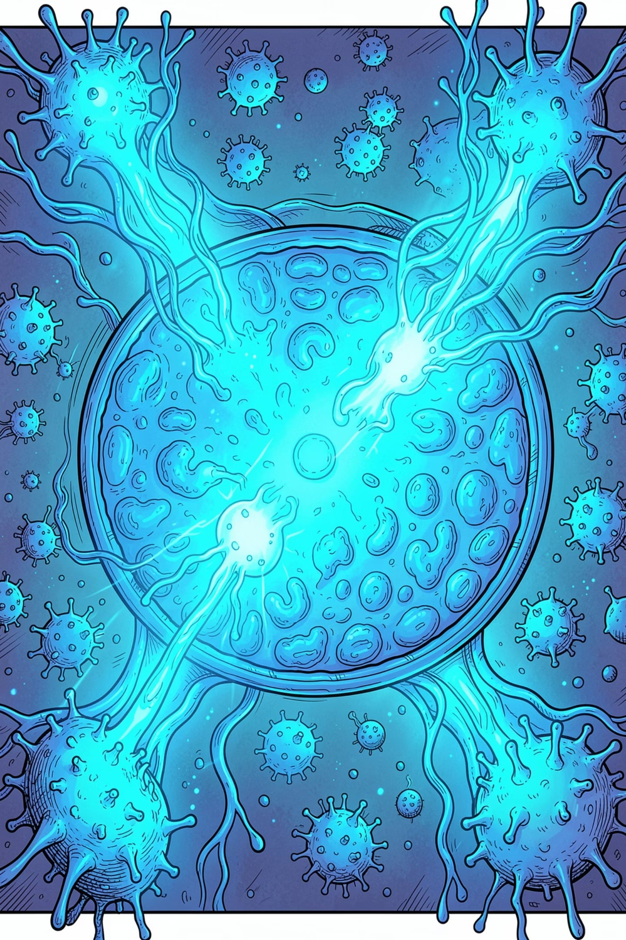
Why Cell Tracking Matters
Cell tracking is foundational to breakthroughs across biomedical research and medicine.
Cancer Research
Track migration and metastasis patterns
Drug Discovery
Quantify cellular response to compounds
Stem Cell & Regenerative Medicine
Verify lineage and differentiation pathways
Digital Pathology
Objective, reproducible quantitative measurements

Slide 4
Project Objectives
CellDynamics AI delivers a fully automated, end-to-end pipeline — from raw microscopy frames to quantitative biological insights.
Detect
Segment
Track
Identify every cell automatically
Precise pixel-level cell boundaries
Assign unique IDs across all frames
Lineage
Report
Detect parent-child relationships
Generate CSV outputs automatically

Slide 5
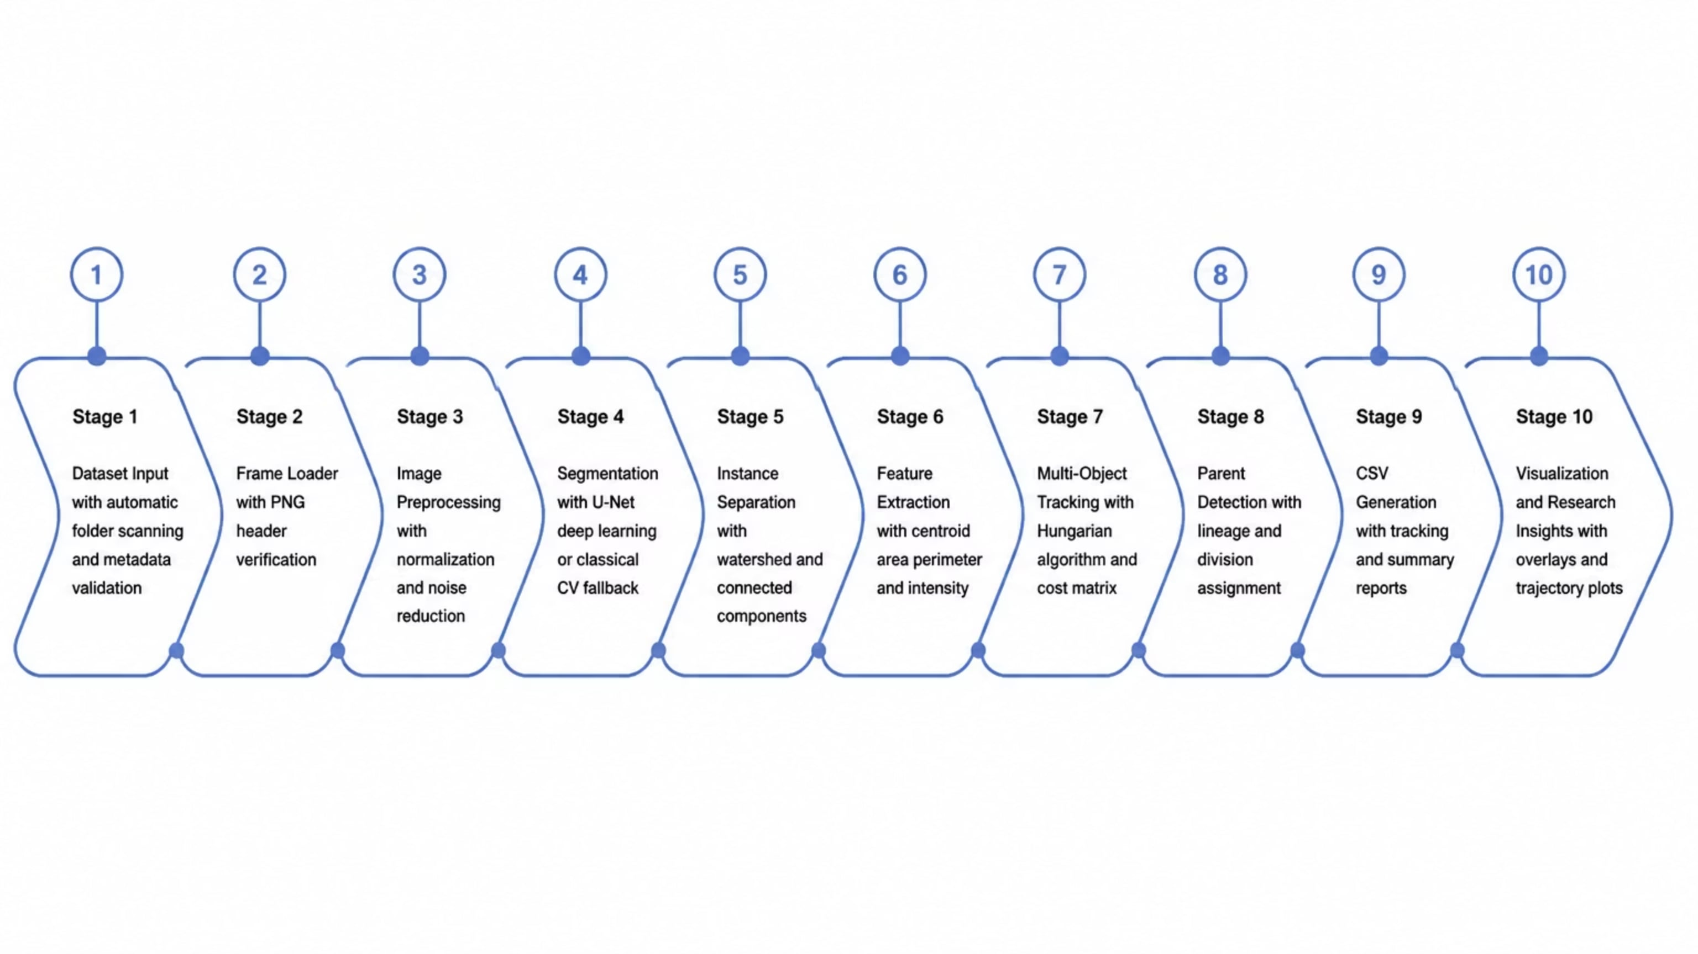
End-to-End System Architecture
A unified, modular pipeline transforms raw microscopy sequences into research-ready quantitative outputs — fully automated at every stage.

Slide 6
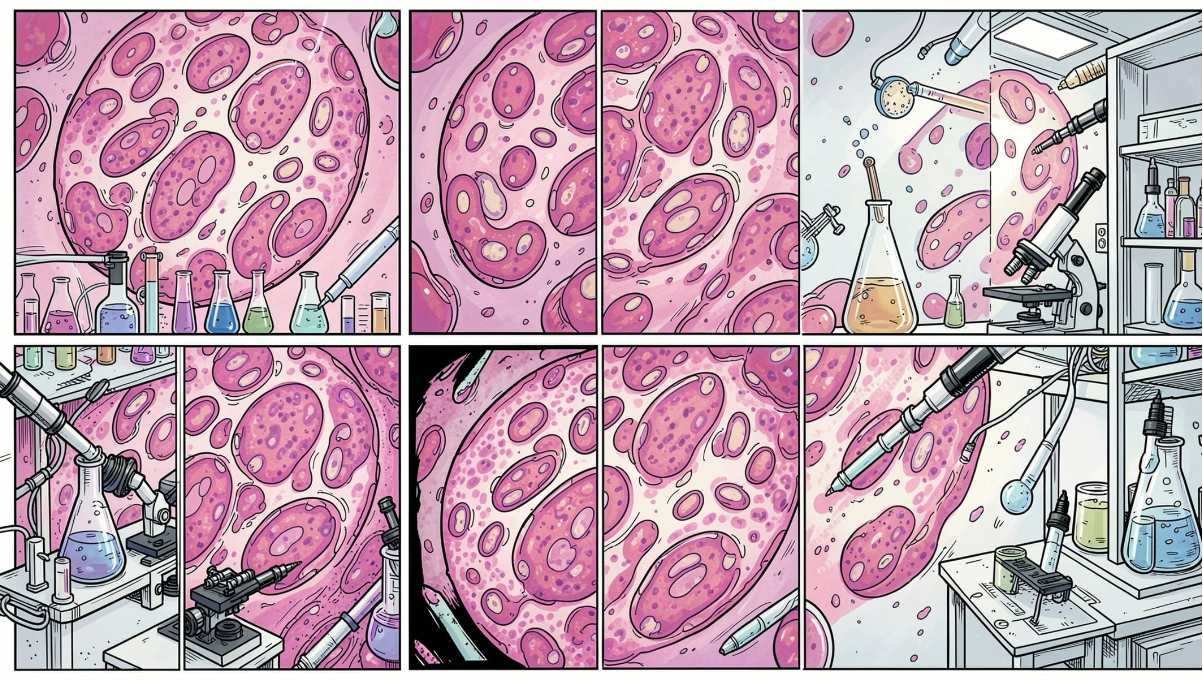
Dataset & Preprocessing Pipeline
Supported Datasets
HeLa · Pancreas · HSC · MUSC — each containing hundreds of PNG frames in continuous time series. Every folder is auto-scanned with metadata validated, frame continuity checked, and missing frames detected automatically.
Preprocessing Steps
01
02
Frame Loading
Intensity Normalization
PNG header verification and continuity check
Percentile clipping and contrast enhancement
03
04
Noise Reduction
Enhanced Output
Gaussian blur and background subtraction
Normalized, clean image ready for segmentation

Slide 7
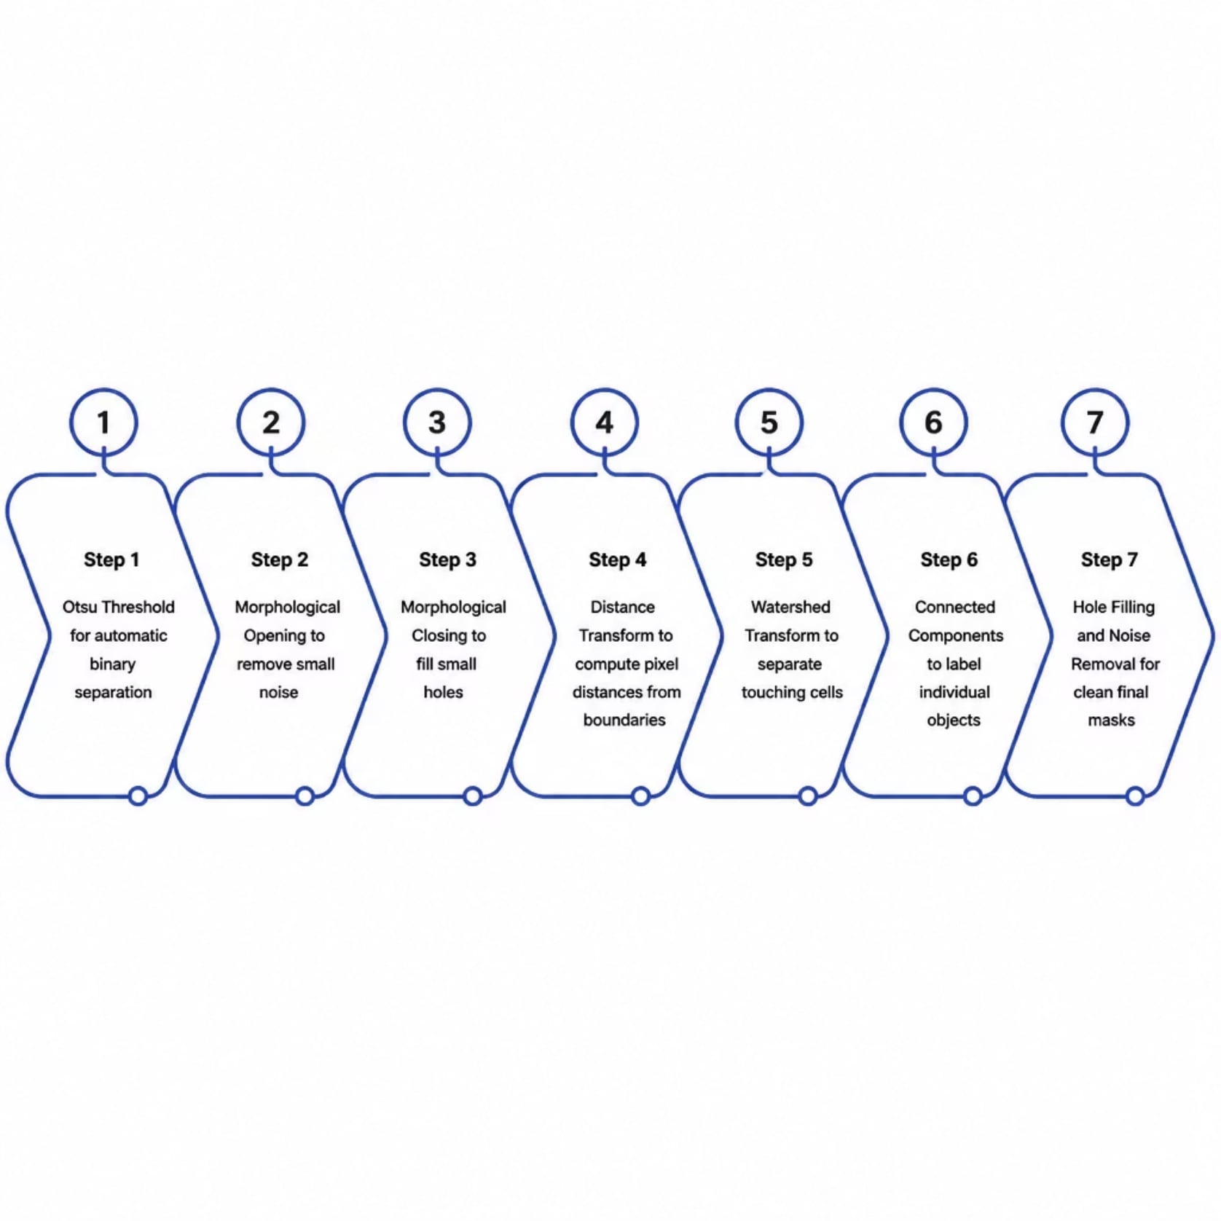
Segmentation: Dual-Mode Intelligence
CellDynamics AI uses a deep learning primary (U-Net) with an automatic classical CV fallback — ensuring robustness even without trained models.
Classical CV Pipeline
Otsu Threshold
Morphological Ops
Automatic binary separation
Opening and closing for noise removal
Watershed
Connected Components
Separate touching and overlapping cells
Label each cell as a unique object

Slide 8
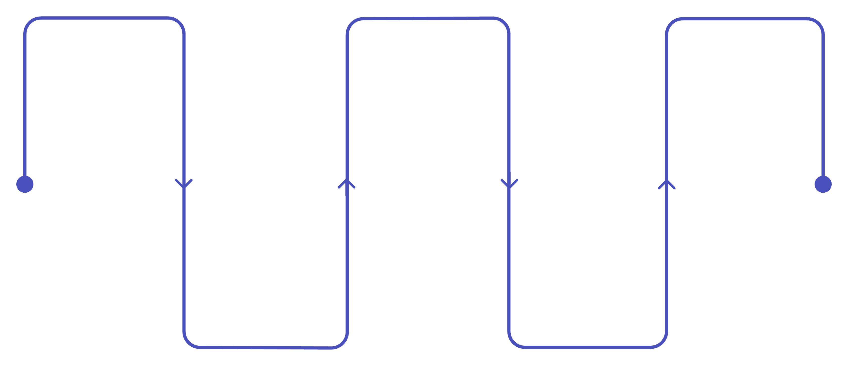
U-Net Architecture & Training Pipeline
Encoder
Decoder
Output
Convolution blocks + max pooling
Transpose conv upsampling
Sigmoid for binary mask
Skip Connections
Bottleneck
Deepest feature representation
Link encoder and decoder levels

Slide 9
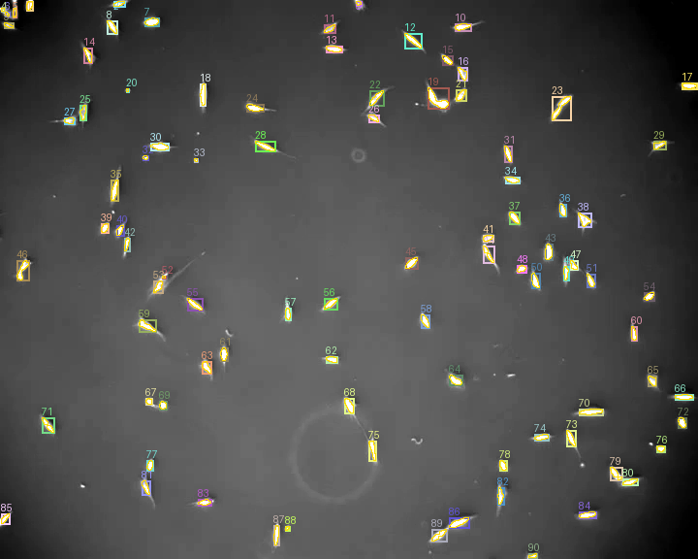
Progress of Projects
The project has made many claims so far about its use and results but here are the raw results
Textual Output
Click here for seeing the data
Image Output
Click here to see the image output
Textual Output Summary
Click here to see the run summary
Visualization
Click here to see the visual memory
Up: Real image of our programs last run, marking each cell with a cell id

Slide 10

Tracking & Lineage Detection
A tracking-by-detection approach assigns unique IDs across frames using a multi-parameter cost function and the Hungarian algorithm. When a cell disappears, lineage logic detects parent-child division events.
Compute Cost
Assign IDs
Use distance, IoU, area, intensity.
Apply Hungarian algorithm for optimal matches.
Detect Cells
Parent Detection
Find cells and create feature vectors.
Search nearby cells to assign lineage.

Slide 11
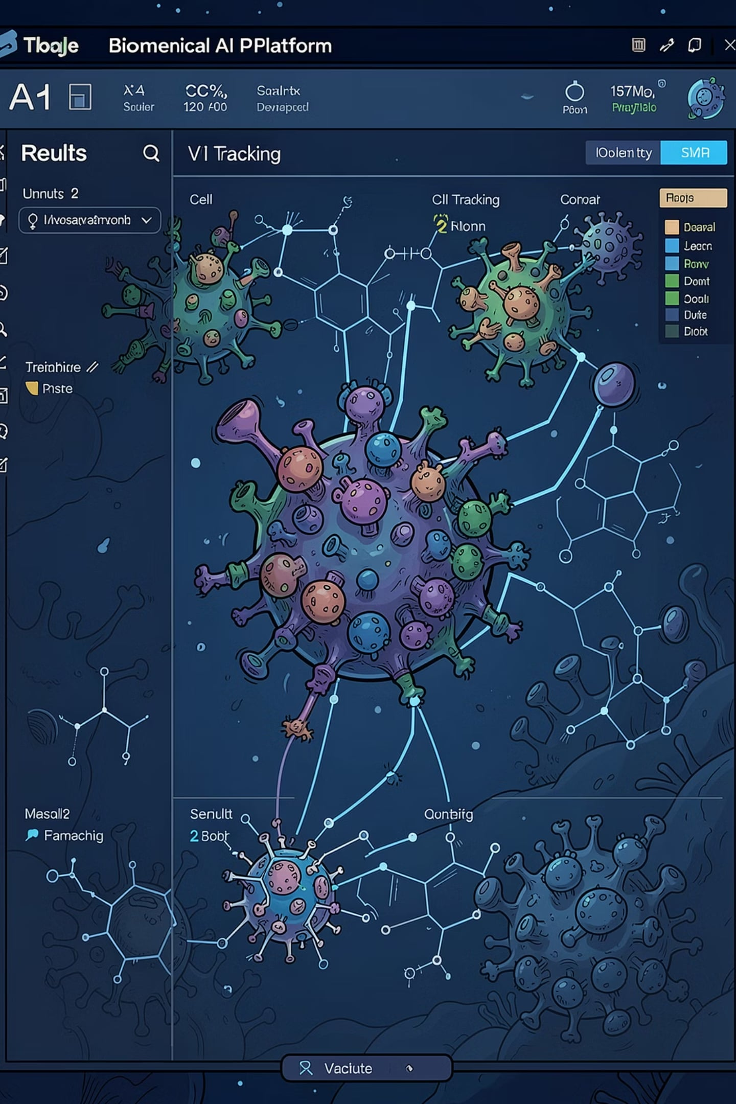

Outputs, Applications & What's Next
📊 Outputs
Binary masks, overlay images, tracking CSV, summary reports, logs, and checkpoints
🏥 Applications
Cancer research, drug discovery, stem cell lineage, digital pathology, regenerative medicine
🔬 Limitations
Requires labeled masks for training; CPU slower than GPU; dense overlap remains challenging
🚀 Future Scope
Vision Transformers, Segment Anything Model, 3D tracking, cloud dashboards, real-time analysis
Technologies: Python · PyTorch · NumPy · SciPy · Pandas · scikit-image · Hungarian Algorithm · U-Net · Watershed · Otsu

